Slide 1
Cyclistic Marketing Strategy
2020 - 2021
Cyclistic Bike-Share Analysis
Google Data Analytics Case Study
Dawid Sosinski
21/12/2021

Slide 2
Table of Content
Why do we need a new marketing strategy?
How are we going to design our strategy?
Gender
Age
Trip duration
What do we need to do?
How will we measure our success?
Next actions
Appendix

Slide 3
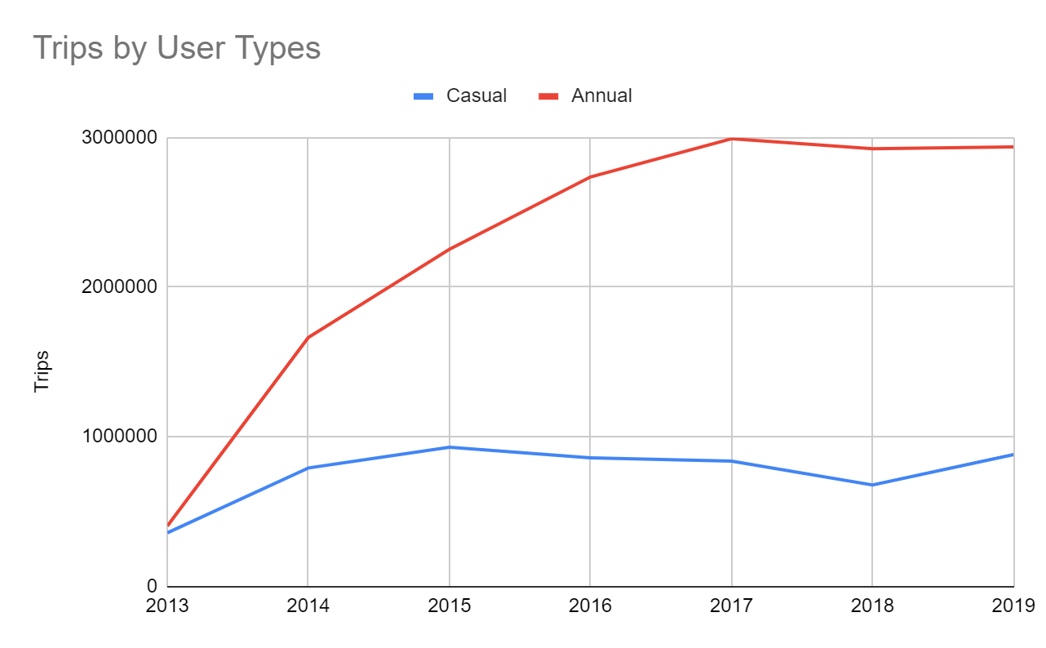
Why do we need a new marketing strategy?
The future success of our company depends on maximizing the number of annual memberships
23% of all trips in 2019 where made by casual riders
In order to grow company profits we need to
convert casual riders into annual members
We need to understand how annual members
use Cyclistic bikes service

Slide 4
How are we going to design our strategy?
We need to create an idea annual membership customer profile
The profile will identify our annual member’s gender, age, trip duration
Casual rider trip data will be checked for customer conversion opportunities

Slide 5
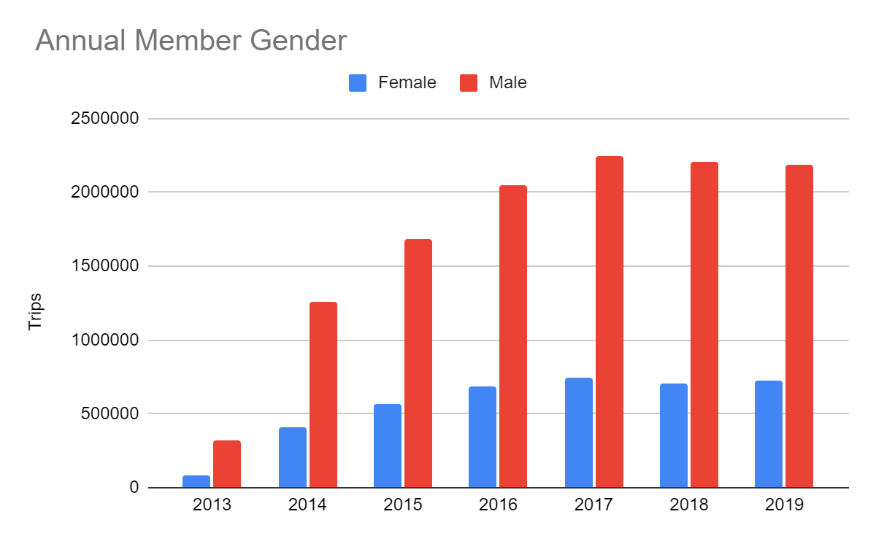
Annual Member Gender
Male riders made majority of trips every year
from 2013 until 2019
75% of all trips in 2019 were made by
male riders
Male riders are more likely to use our
annual membership product

Slide 6
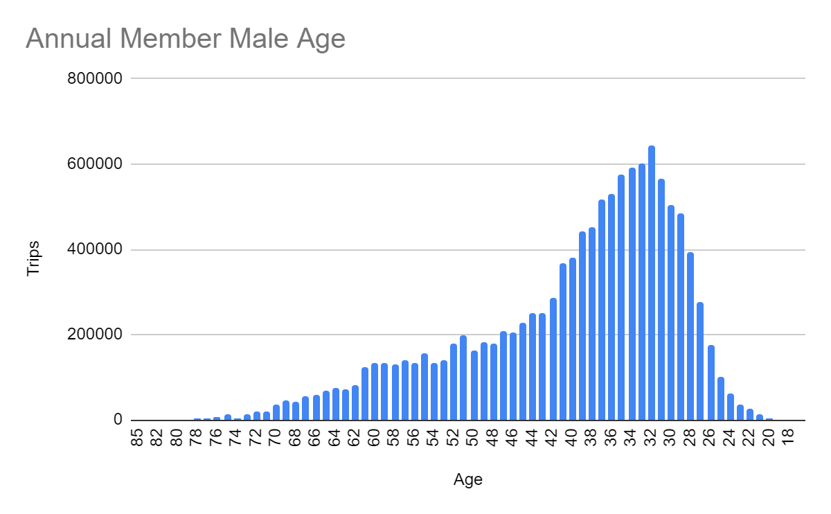
Male Annual Member Age
Male riders between age 26 and 40
made majority of all trips

Slide 7
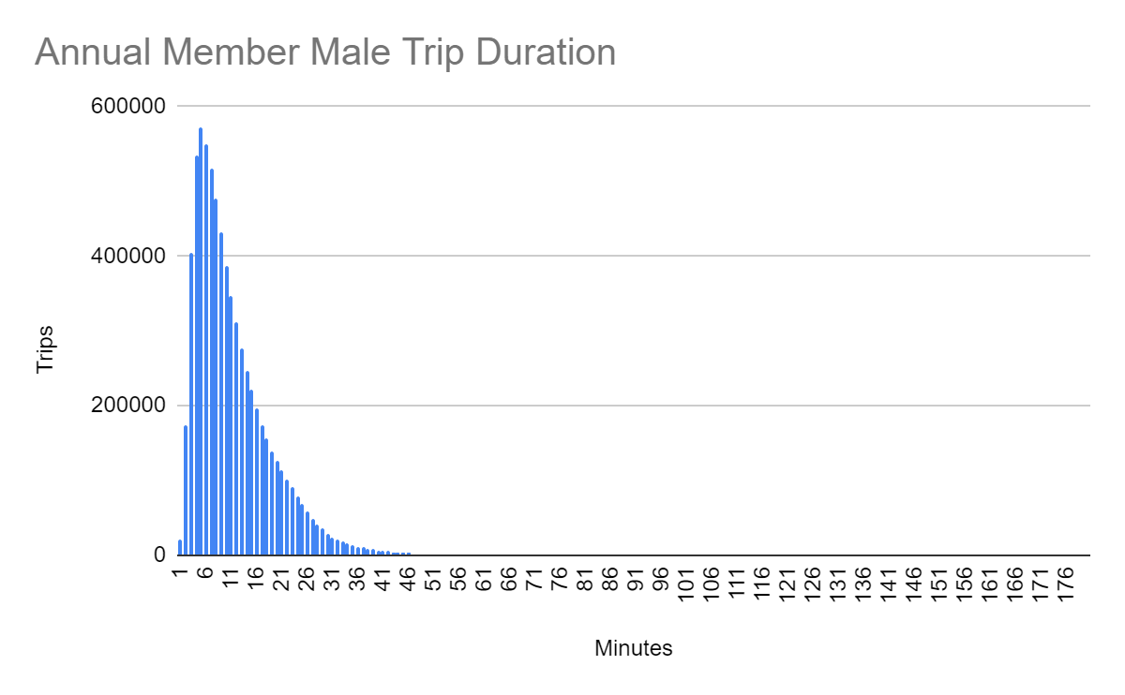
Male Annual Member Trip Duration
Majority of trips lasted between
1 and 16 minutes

Slide 8
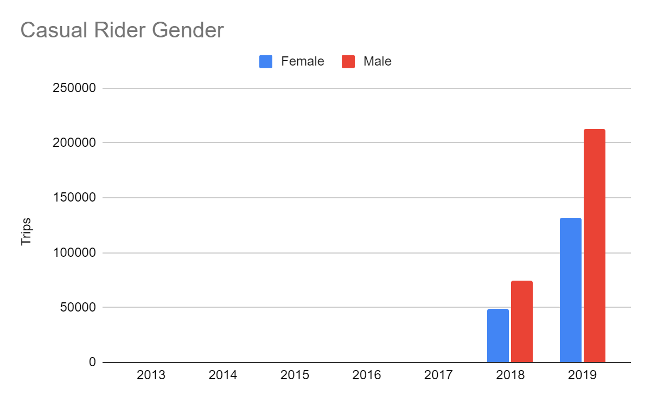
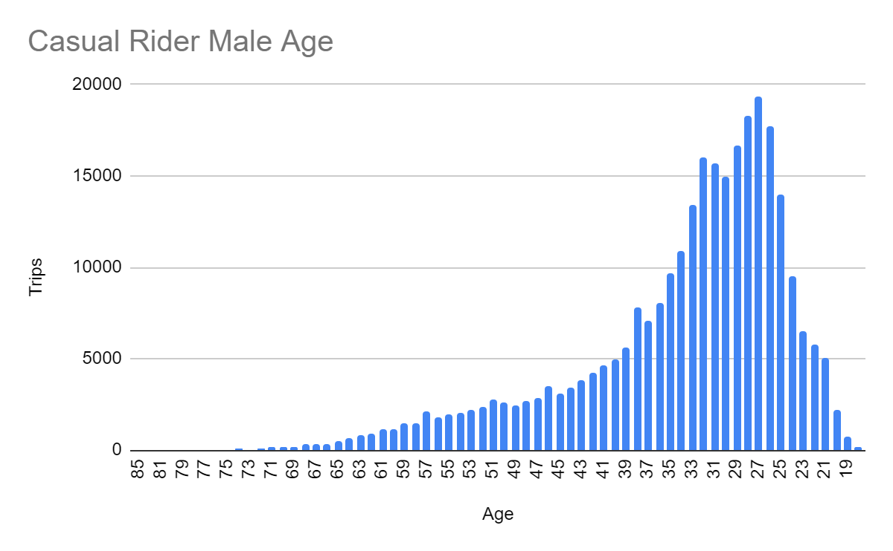
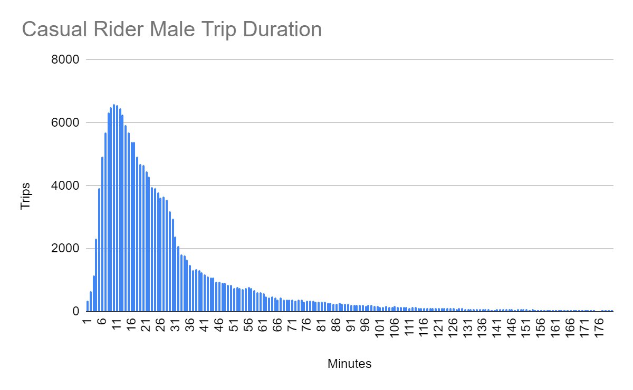
What do we need to do?
The annual membership customer profile
consists of:
Male riders
Age between 26 and 40
Ride between 1 min and 16 mins
Casual rider data indicates that 56240 trips were made in 2019 (16%) with the same customer profile

Slide 9
How will we measure our success?
By creating new targeted marketing campaign we can convert:
26% of male casual rider trips into annual membership
Which is 16% of all trips made in 2019
That will increase profits by 10% in 2020

Slide 10
Next Actions
Time to review and discuss presented information
Follow-up meeting
Campaign Approval

Slide 11
Appendix
Project Plan and Execution Documentation here
Data used here
Any questions - contact dsosinski@gmail.com

